Slide 1
CSE 205
Digital Logic Design
Week 4
Dr. Mahmuda Naznin

Slide 2
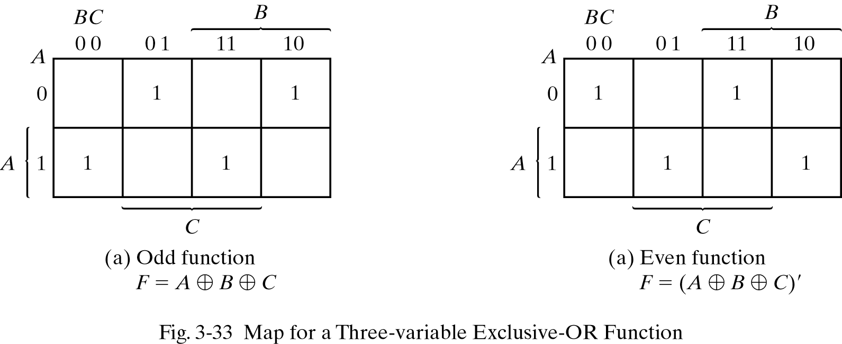
Three-input XOR Function
F = A XOR B XOR C
Multiple input XOR is 1 only if the number of 1 variables is odd: ODD function

Slide 3
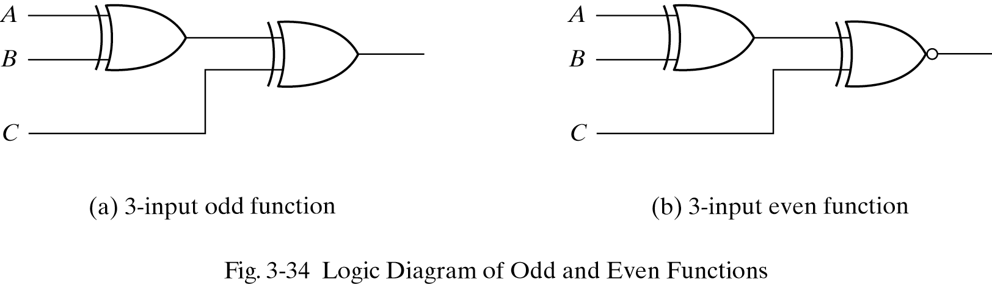
ODD Function Implementation

Slide 4
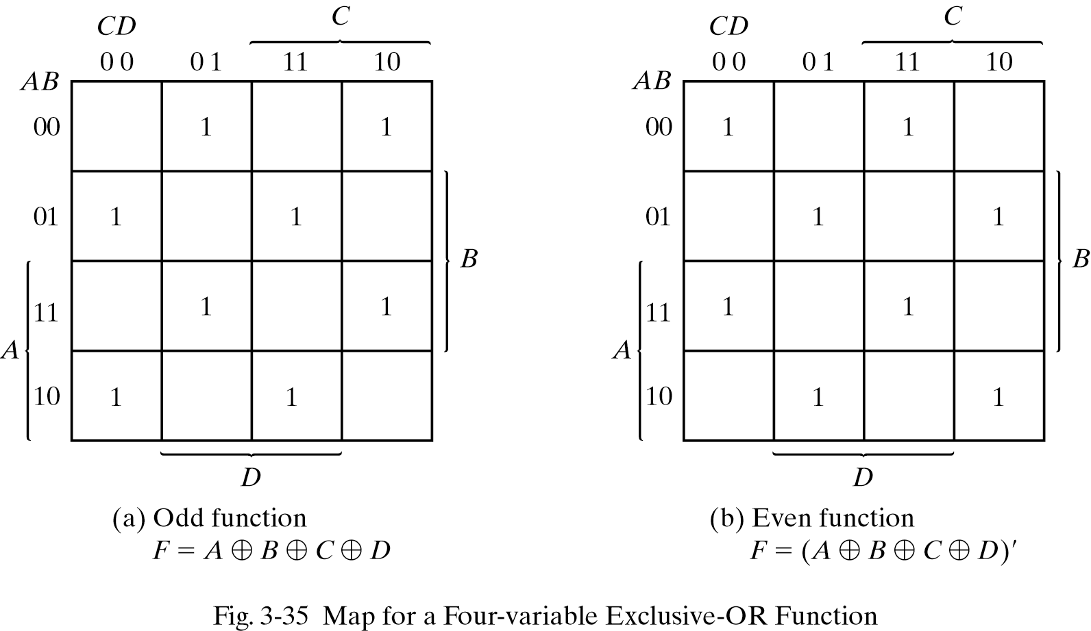
Four-input XOR Function
F detects odd number of 1s, F’ detects even number of 1’s

Slide 5
Parity Generation and Checking
Parity bit: extra bit to ensure correct transmission of data
Parity bit is included in the message to make the number of 1s either odd (odd parity) or even (even parity).
We can use XOR to see if the number of 1’s is odd.
We can use XOR-invert to see if the number of 1’s is even.
We include the XOR output in the message
Later at receiver we check the number of 1 bits to see if the transmission is correct.

Slide 6
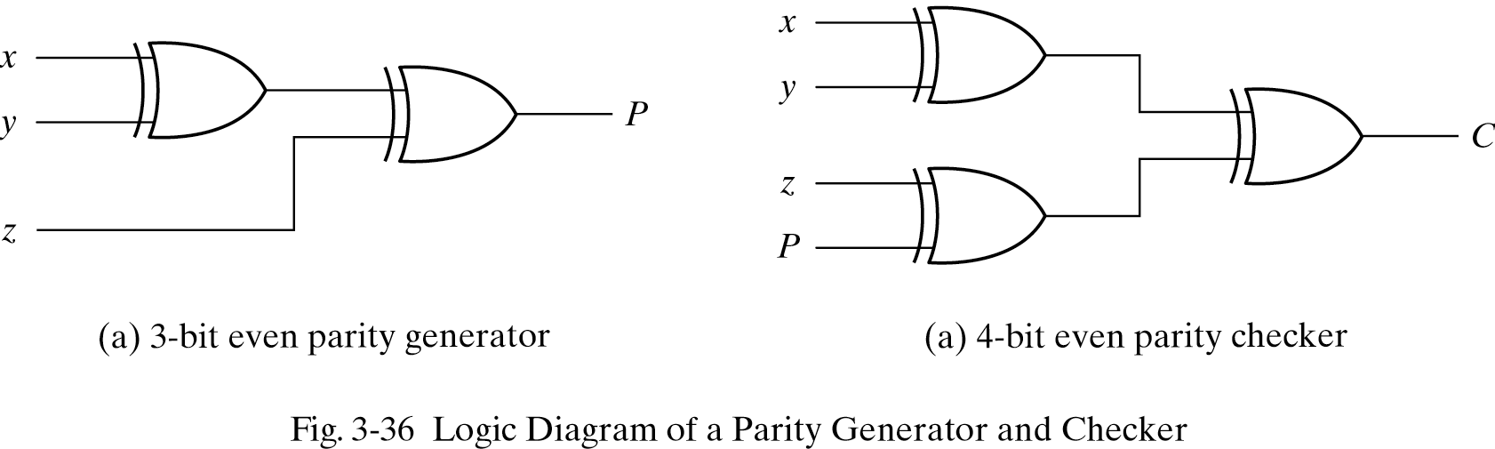
Parity Generation and Checking

Slide 7
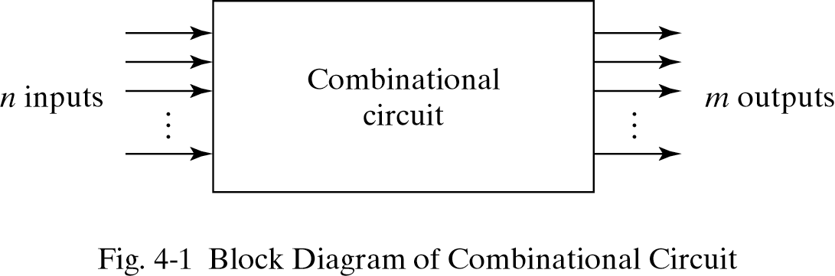
Combinational Logic
Combinational Logic: Output only depends on current input
Sequential Logic: Output depends on current and previous inputs

Slide 8
Design Procedure (Steps)
1. Find the number of input variables and outputs
2. Derive the truth table
3. Obtain the Boolean Function
4. Minimize the function
5. Draw the logic diagram, verify correctness

Slide 9
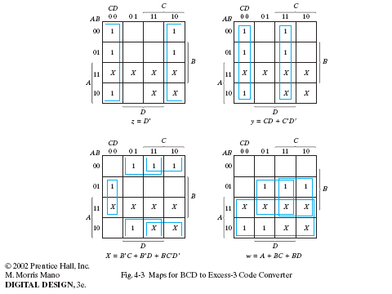

Slide 10
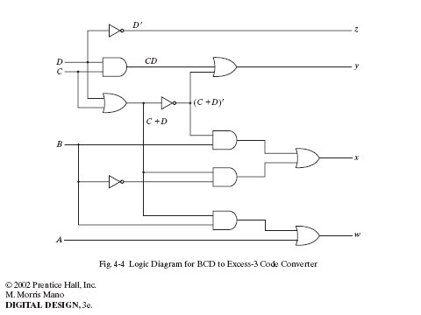

Slide 11
Design Procedure: 1 bit Adder
Binary Adder-Subtractor
Basic block is a half adder.
Half Adder Design:
1. needs 2 inputs 2 outputs
2. Truth Table:
x y C S
0 0 0 0
0 1 0 1
1 0 0 1
1 1 1 0
3. S=x’y+xy’ = x.XOR.y
C=xy

Slide 12
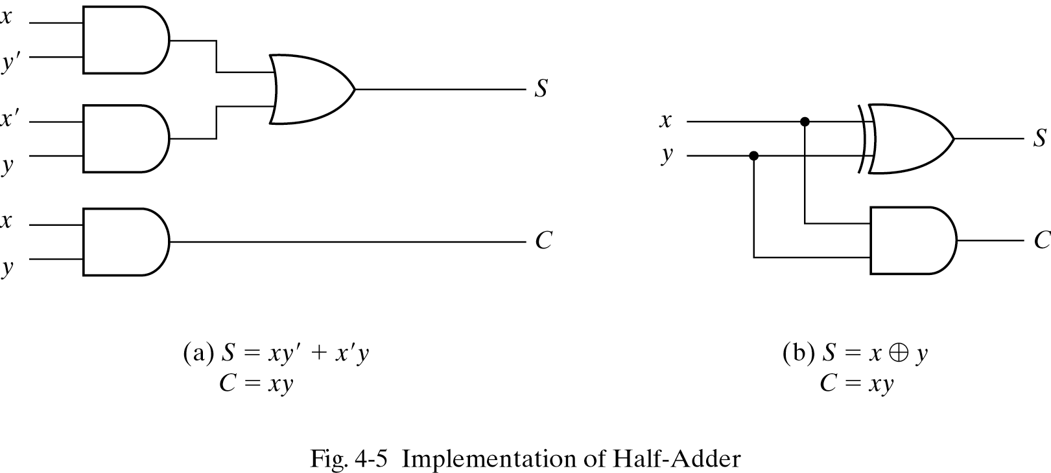
Half -Adder Circuit

Slide 13
Full-Adder
Truth Table:
x y z C S
0 0 0 0 0
0 0 1 0 1
0 1 0 0 1
0 1 1 1 0
1 0 0 0 1
1 0 1 1 0
1 1 0 1 0
1 1 1 1 1

Slide 14
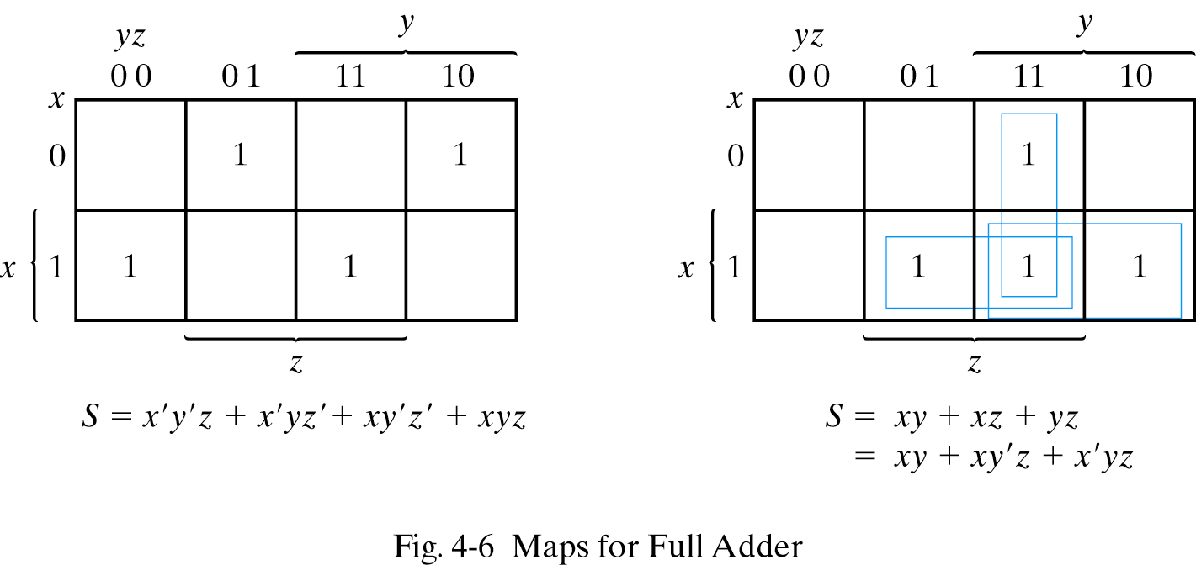
Full Adder K-Map

Slide 15
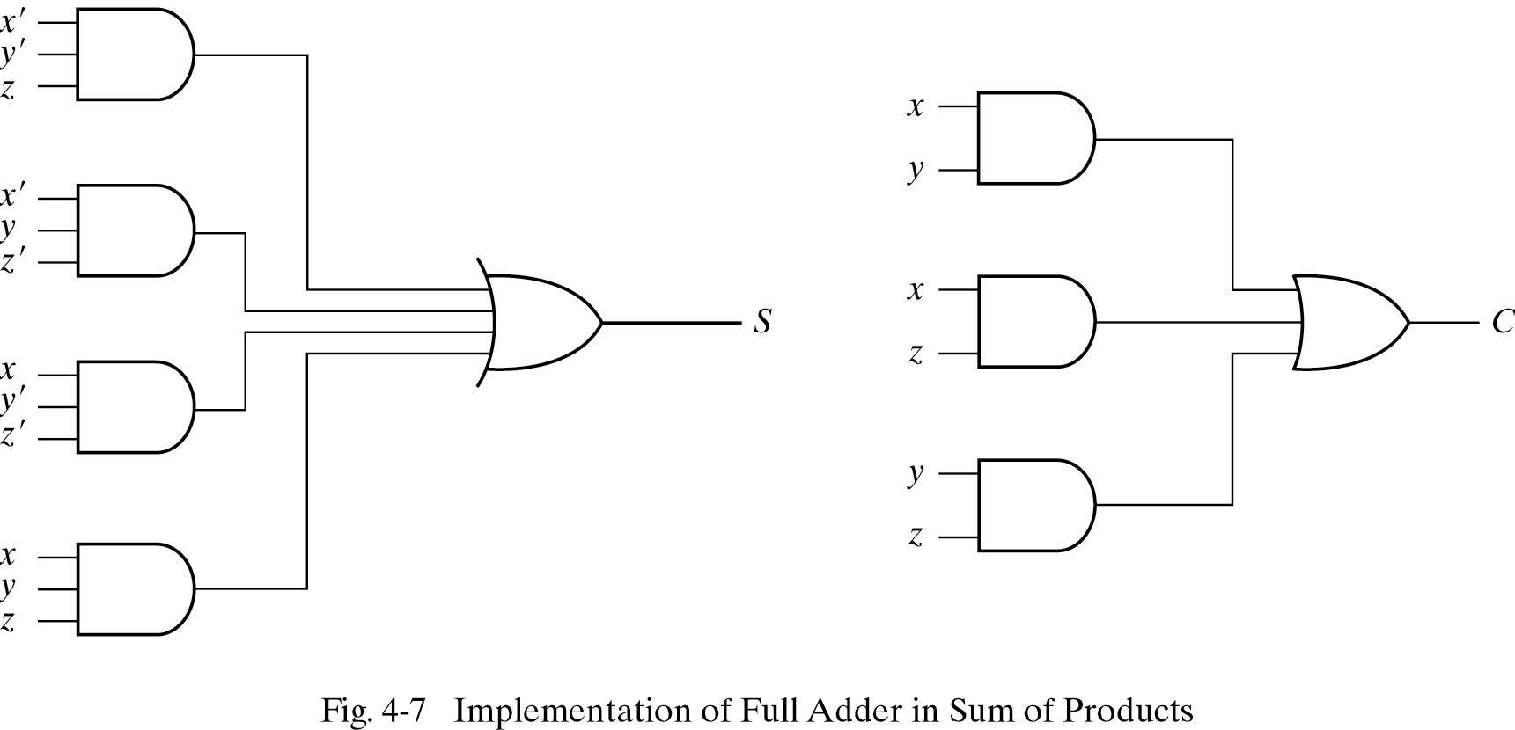
Full Adder Circuit

Slide 16
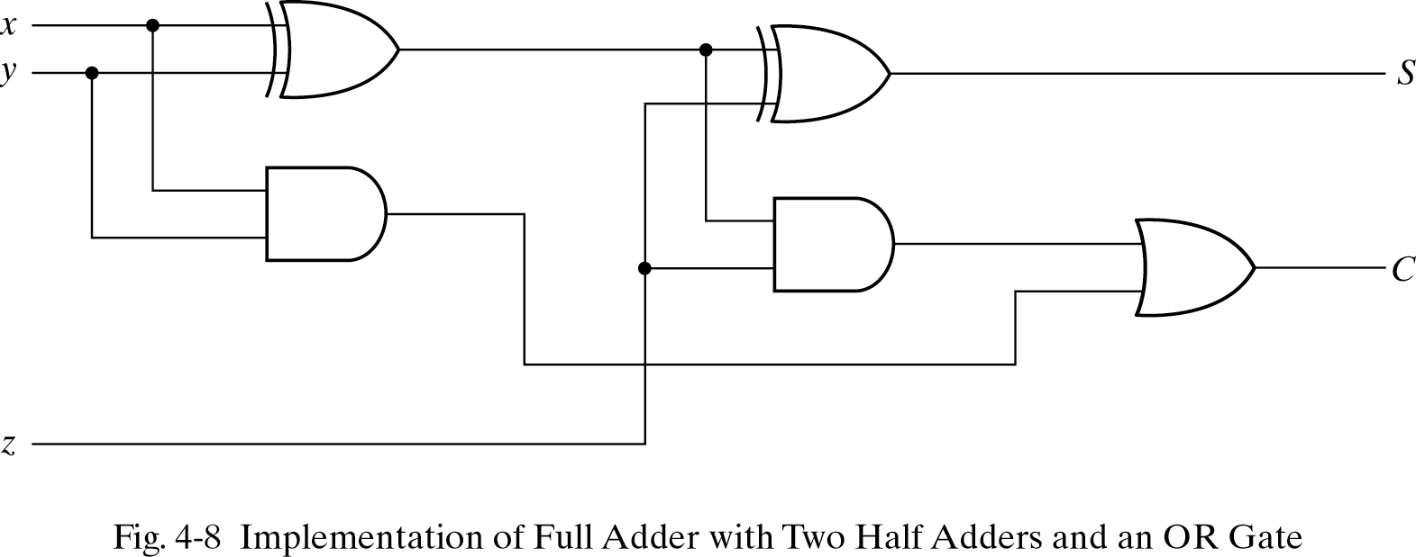
Full Adder Circuit
Half adder ?

Slide 17
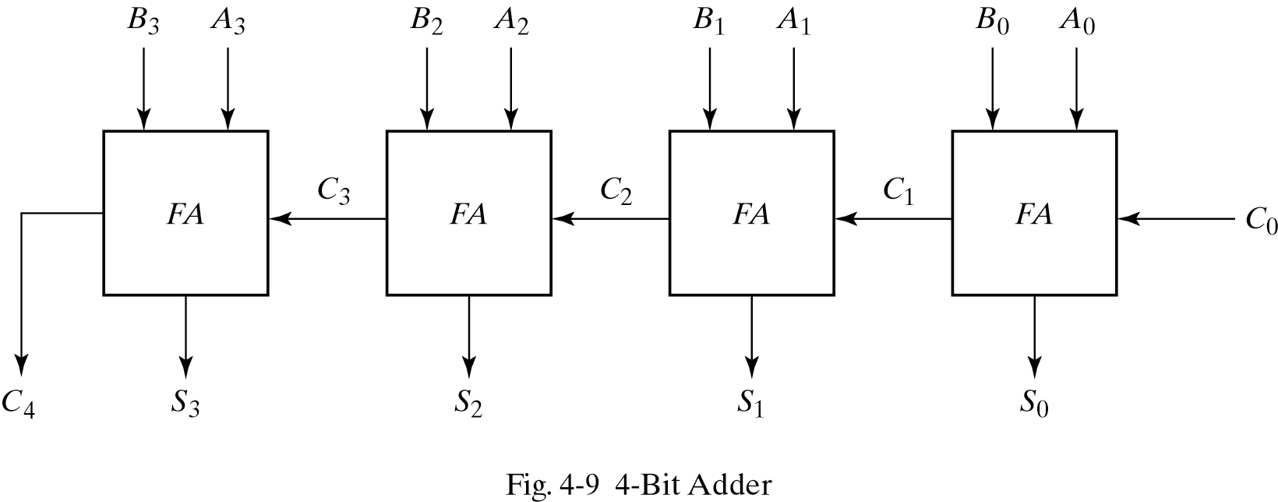
4-bit Adder Circuit
But this is slow...

Slide 18
Carry Look Ahead Adder Circuit
P-Carry propagator, G- Carry generator
P_{i} = A_{i} ⊕ B_{i}
G_{i} = A_{i} · B_{i}
The output sum and carry can be expressed as
Sum_{i} = P_{i} ⊕ C_{i} = A_{i} ⊕ B_{i} ⊕ C_{i}
C_{i+1} = G_{i} + ( P_{i} · C_{i}) = (A_{i} ⊕ B_{i} ) C_{i} + A_{i} . B_{i}
Having these we could design the circuit. We can now write the Boolean function for the carry output of each stage and substitute for each Ci its value from the previous equations:
C₁ = G₀ + P₀ · C₀
C₂ = G₁ + P₁ · C₁ = G₁ + P₁ · G₀ + P₁ · P₀ · C₀
C₃ = G₂ + P₂ · C₂ = G₂ P₂ · G₁ + P₂ · P₁ · G₀ + P₂ · P₁ · P₀ · C₀
C₄ = G₃ + P₃ · C₃ = G₃ P₃ · G₂ P₃ · P₂ · G₁ + P₃ · P₂ · P₁ · G₀ + P₃ · P₂ · P₁ · P₀ · C₀

Slide 19
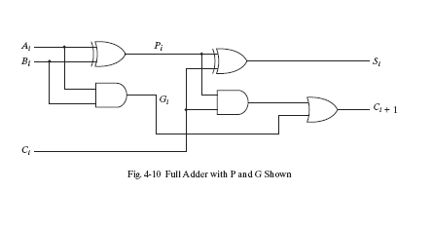

Slide 20
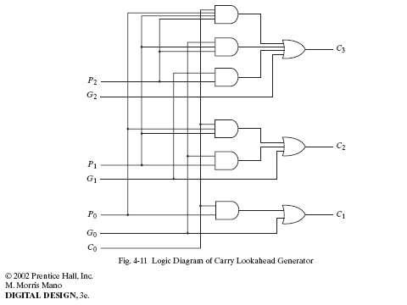

Slide 21
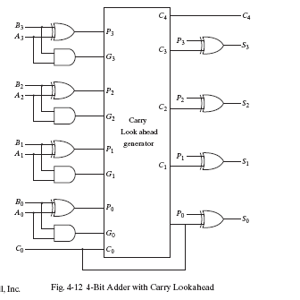

Slide 22
Binary Subtractor
Subtraction is done by using complements
A’s 2’s Complement = A’+1
A-B= A + (B’+1)=A+(-B)

Slide 23
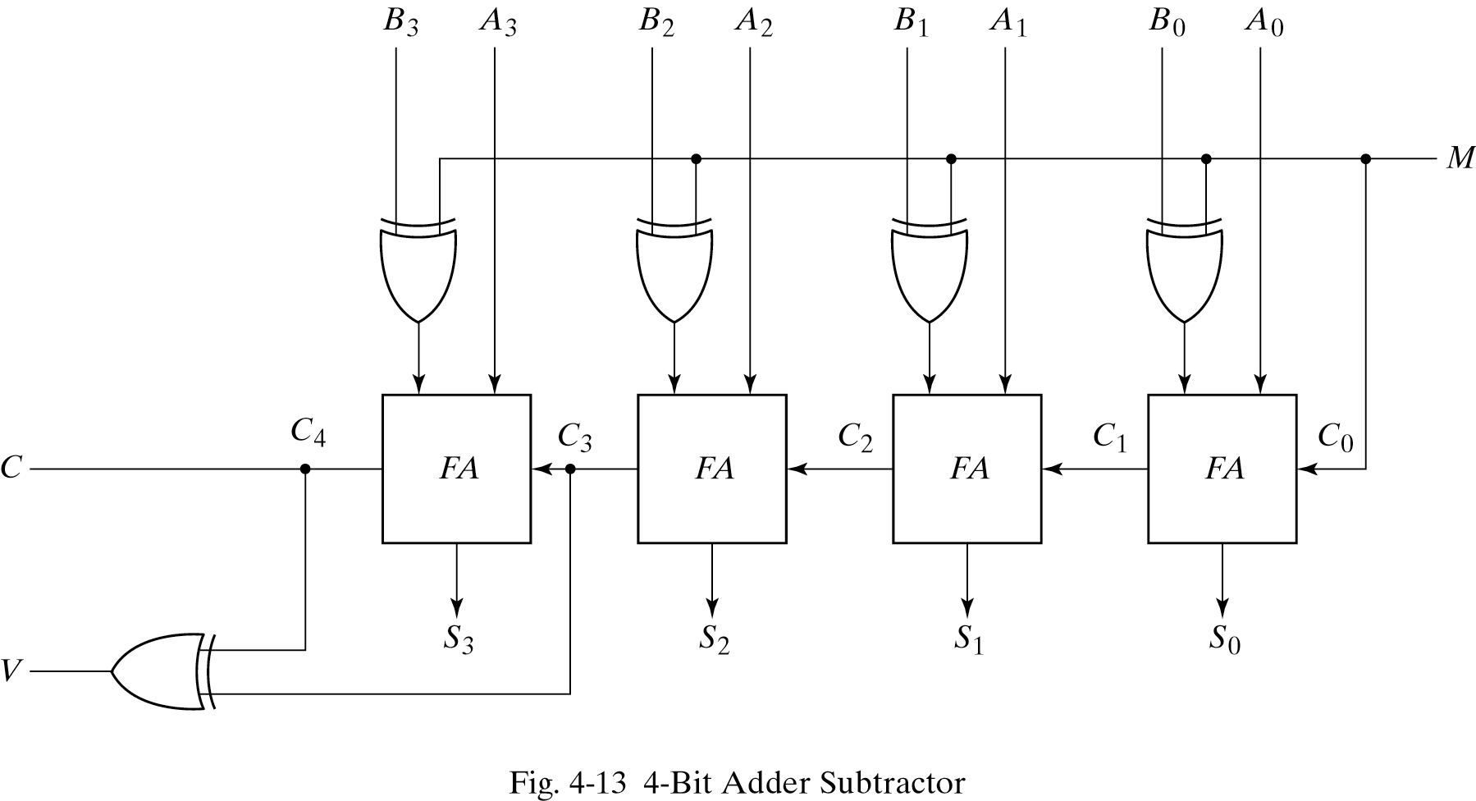
4-bit Adder-Subtractor

Slide 24
Decimal Adder
When dealing with decimal numbers BCD code is used.
A decimal adders requires at least 9 inputs and 5 outputs.
BCD adder: each input does not exceed 9, the output can not exceed 19
How are decimal numbers presented in BCD?
Decimal Binary BCD
9 1001 1001
19 10011 (0001)(1001)
1 9

Slide 25
Decimal Adder
Decimal numbers should be represented in binary code number.
Example: BCD adder
Suppose we apply two BCD numbers to a binary adder then:
The result will be in binary and ranges from 0 through 19.
Binary sum: K(carry) Z8 Z4 Z2 Z 1
BCD sum : C(carry) S8 S4 S2 S1
For numbers equal or less than 1001 binary and BCD are identical.
For numbers more than 1001, we should add 6(0110) to binary to get BCD.
Example: 10011(binary) = 11001(BCD) =19
ADD 6 to correct.

Slide 26
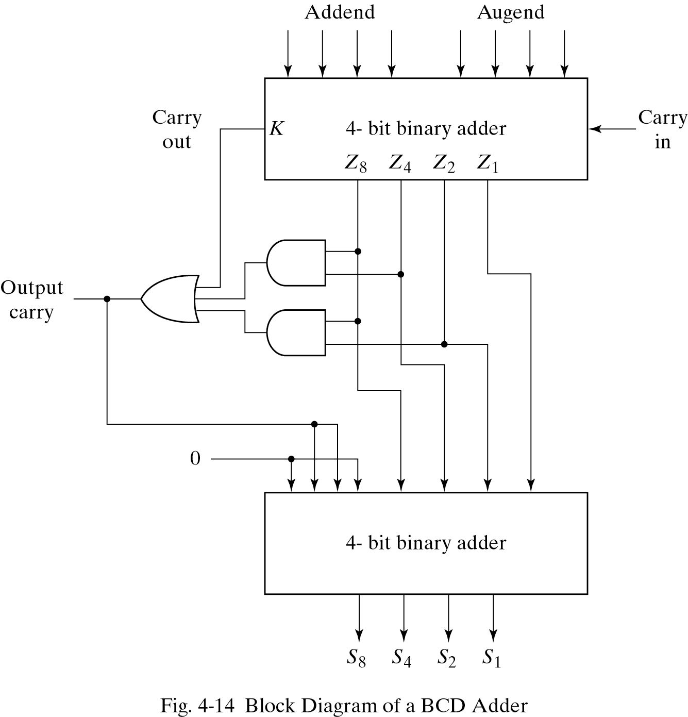
BCD adder
Binary Output:
K Z8 Z4 Z2 Z1
________________
0 1 0 1 0 (10)
0 1 0 1 1 (11)
0 1 1 0 0 (12)
0 1 1 0 1 (13)
0 1 1 1 0 (14)
0 1 1 1 1 (15)
1 0 0 0 0 (16)
1 0 0 0 1 (17)
1 0 0 1 0 (18)
1 0 0 1 1 (19)
For BCD format (add 6)
BCD Output:
C S8 S4 S2 S1
________________
1 0 0 0 0 (10)
1 0 0 0 1 (11)
1 0 0 1 0 (12)
1 0 0 1 1 (13)
1 0 1 0 0 (14)
1 0 1 0 1 (15)
1 0 1 1 0 (16)
1 0 1 1 1 (17)
1 1 0 0 0 (18)
1 1 0 0 1 (19)
C
C=K +Z8.Z4+Z8.Z2
Decides to add 6?

Slide 27
Binary Multiplier
Binary mult. Is done the same way of decimal mult.
Multiplicand is multiplied by each bit of the multiplier.

Slide 28
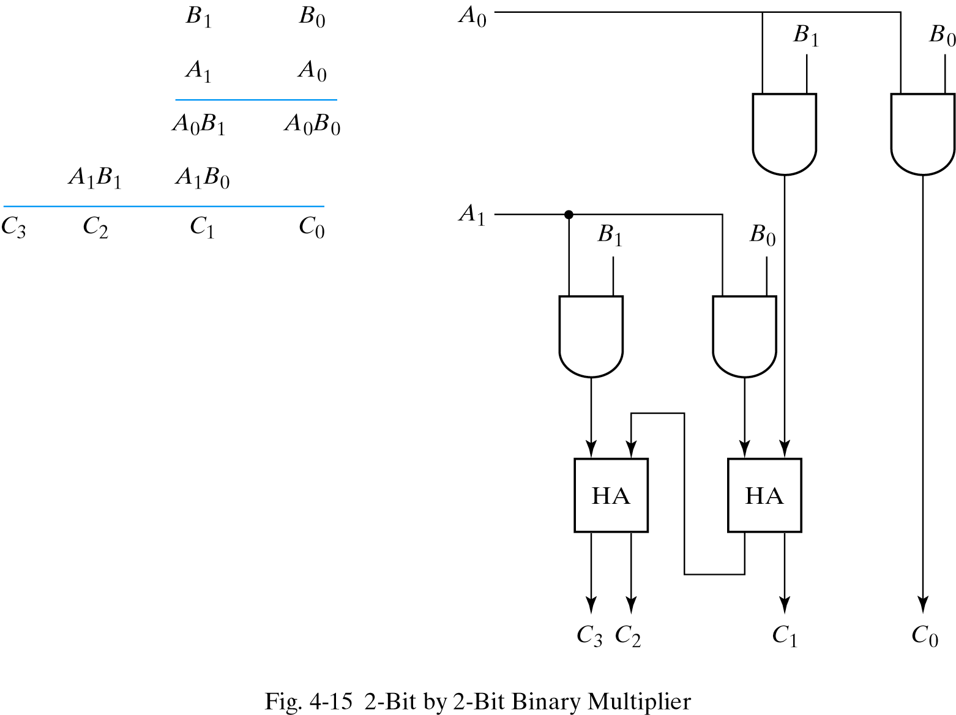
Binary Multiplier

Slide 29
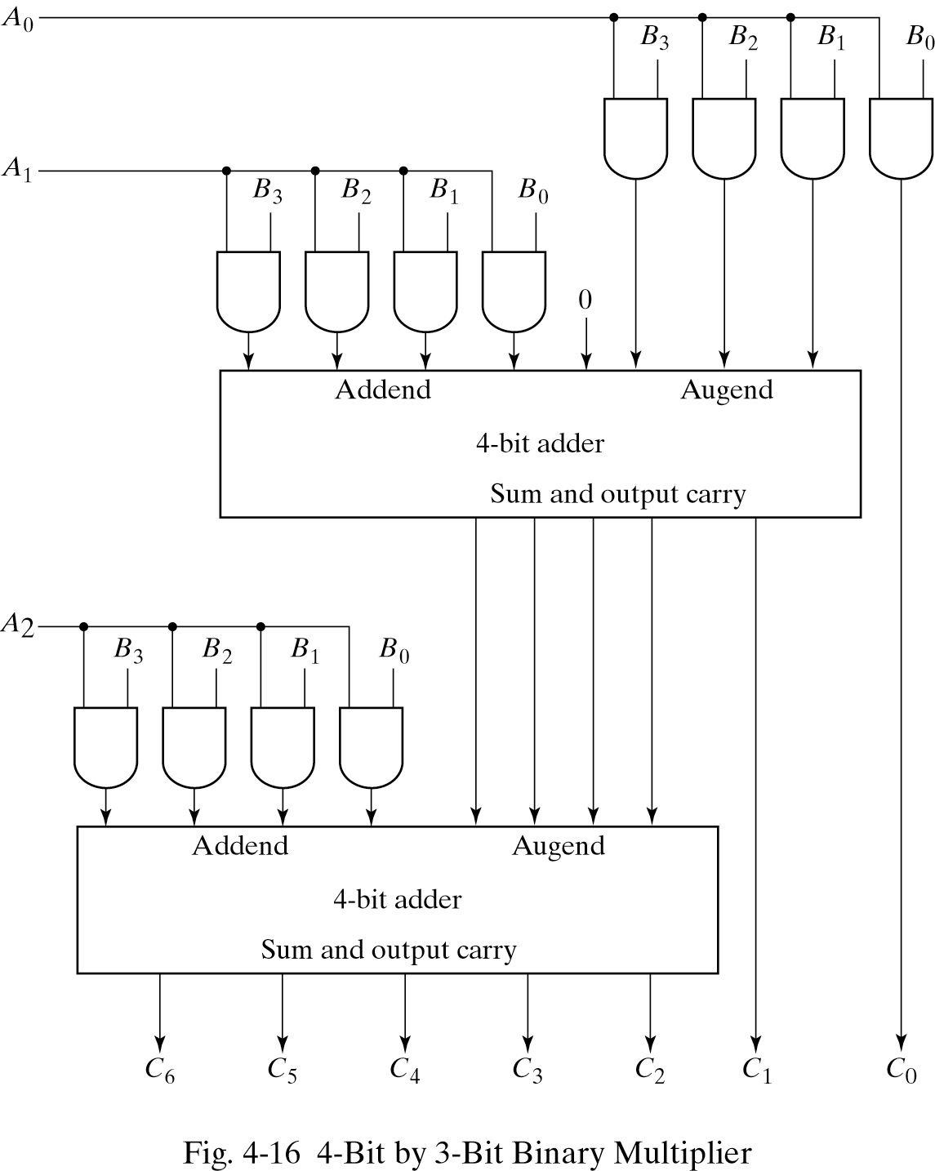
4-bit by 3-bit Binary Multiplier
B3 B2 B1 B0
A2 A1 A0
A0B3 A0B2 A0B1 A0B0
A1B3 A1B2 A1B1 A1B0
A2B3 A2B2 A2B1 A2B0

